Slide 1


SPS Information Day in Bulgaria
MYP G6006: “Acoustic Multi-Functional Composites for Environmental Risks and Health Hazards Reduction”
Dr. Roumen Iankov, Institute of Mechanics, Bulgarian Academy of Sciences
PUBLIC

Slide 2



G6006: Acoustic Multi-Functional Composites for Environmental Risks and Health Hazards Reduction
G6006 \ project participants
 | Title and Name | Institution | Country
NPD | Prof. Dr. Roumen Iankov | Institute of Mechanics (IMech) at the Bulgarian Academy of Sciences (BAS) | Bulgaria
PPD | Prof. Dr. Momir Prascevic | Faculty of Occupational Safety (FOS) at the University of Nis | Serbia
Co-Director | Prof. DSc Nodira Abed | STC "Fan va tarakkiyot" at Tashkent State Technical University (TSTU) | Uzbekistan
PUBLIC
Notes:
The project involves – 1 NATO country and 2 NATO partner countries

Slide 3
G6006: Acoustic Multi-Functional Composites for Environmental Risks and Health Hazards Reduction
 | Title and Name | Institution | Fields of expertise/excellence
NPD | Prof. Dr. Roumen Iankov | Imech BAS | Mathematical modelling and numerical simulations by means of advanced FE software of complex material behaviour for various industrial applications as well as in material properties identification via back analysis
PPD | Prof. Dr. Momir Prascevic | FOS UNI | Development of methodologies and tools for protection against urban noise. Environmental and industrial noise monitoring. Acoustic parameters material characterisation technique.
Co-Director | Prof. DSc Nodira Abed | FT-TSTU | Development of new vibration-absorbing polymer composite materials and coatings based on organo-mineral ingredients and industrial waste derivatives for the manufacture of parts
PUBLIC
Notes:
The expertise of the project participants is in different scientific fields that complement each other.
This is a good opportunity for successful cooperation in project implementation

Slide 4
G6006: Acoustic Multi-Functional Composites for Environmental Risks and Health Hazards Reduction
G6006\ End users
“Resor” doo Gadzin Han, Serbia
“Piskent Pakhta Tozalash” JSC (Piskent Cotton Gin Plant),
Tashkent region, Uzbekistan
“Kompozit nanotexnologiyasi” Ltd, Tashkent, Uzbekistan
PUBLIC
Notes:
Part of the project are companies that are interested in the results of the project implementation

Slide 5
G6006: Acoustic Multi-Functional Composites for Environmental Risks and Health Hazards Reduction
PUBLIC

Slide 6
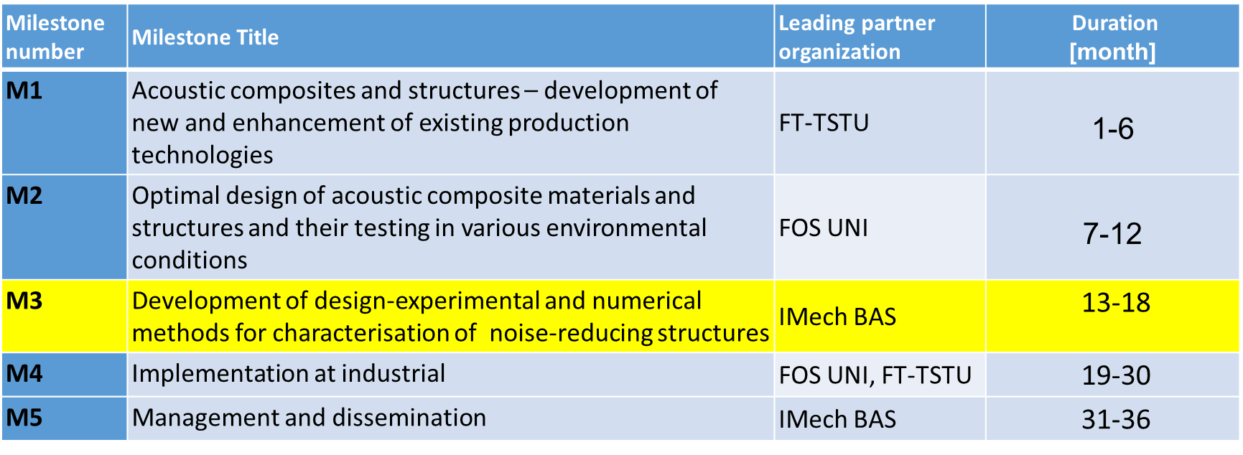
G6006\ Activity overview \ objectives \timeline
NATO SPS Project Kick-Off Meeting, 10, May, 2023 ,Sofia, Bulgaria
PUBLIC
Notes:
At the present moment, October 2024, the implementation of the project is in stage M3
Specific for M3: Objectives and interdependence with other milestones
Development of experimental and numerical methods for designing noise-reducing structures from environmentally friendly composite materials with improved sound-insulating and sound-absorbing properties in a wide frequency range. Finite-element model for calculating and predicting the acoustic characteristics of composites. Development and implementation of the ML-algorithms for optimization of the prediction. During this stage, in-situ measurement setup will be created. Initial data for development will be obtained in M2. The practical results of stage M3 will be used in M4 to confirm the acoustic effectiveness of noise-reducing structures in real conditions of operation

Slide 7
G6006\ Activity overview \ objectives \ Connection with SPS Key Priorities
RESILIENCE
Novel solutions for resilience to man-made, technological and natural hazards employing advance materials and artificial intelligence/ machine learning
Environmental Security:
Security issues arising from key environmental and resource constraints, including health risks, climate change, water scarcity and increasing energy needs, which have the potential to significantly affect NATO’s planning and operations
Security-related Advanced Technology:
Emerging technologies including nanotechnology, optical technology, micro satellites, metallurgy and the development of UAV platforms
PUBLIC
Notes:
A major aspect of the project is RESILIENCE
New solutions for resilience to man-made, technological and natural hazards using advanced materials and artificial intelligence/machine learning
In addition, the results of the project implementation are related to
Environmental safety:
And
Advanced security-related technology:

Slide 8
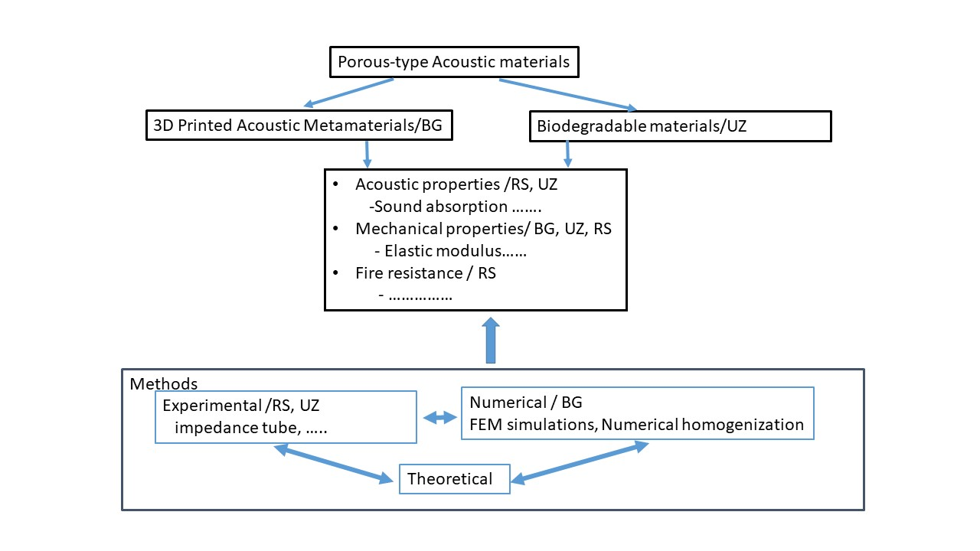
G6006\ working plan \ objectives \ strategy and methodology
Development of
New environmental acoustic materials
Material characteristics to be investigated
Research methods
PUBLIC
Notes:
The project implementation methodology consists of 3 main elements:
- development of new acoustic materials
- Characterization of these materials
- Use of modern experimental and advanced numerical methods.

Slide 9
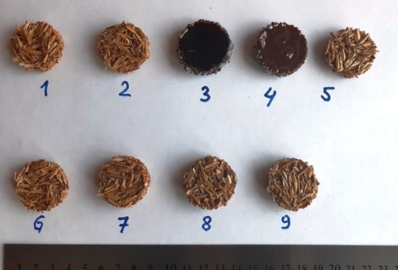
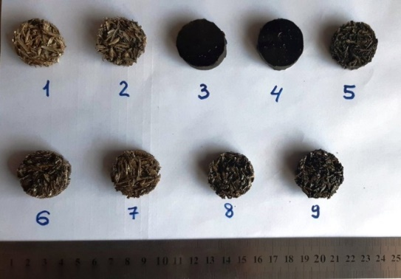
G6006\ Short term outcomes\ M2 \ biodegradable materials
(a)
(b)
Experimental samples based on epoxy resin and rice husk for conducting tests to determine the sound absorption and sound insulation coefficients:
(a) modified with clay minerals (montmorillonite);
(b) modified with carbon nanotubes.
Notes:
During the implementation of the project at stage M2, different compositions of acoustic composite materials were proposed. These compositions are based on epoxy resins and use the main (by volume) natural filler, which is rice husk - this is a by-product of the rice processing industry, obtained from a grain processing company in Uzbekistan

Slide 10
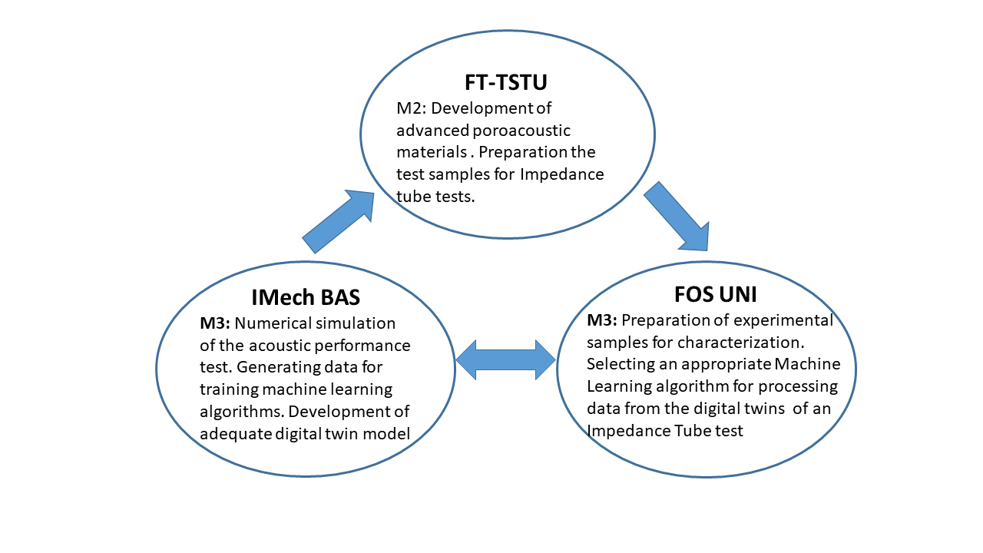
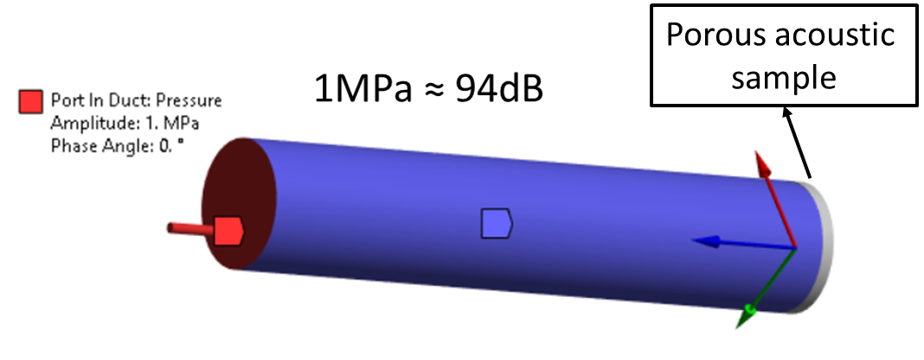
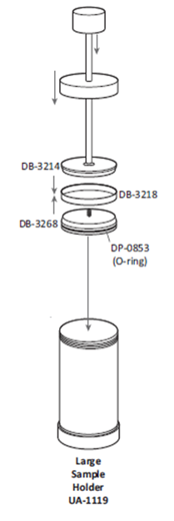
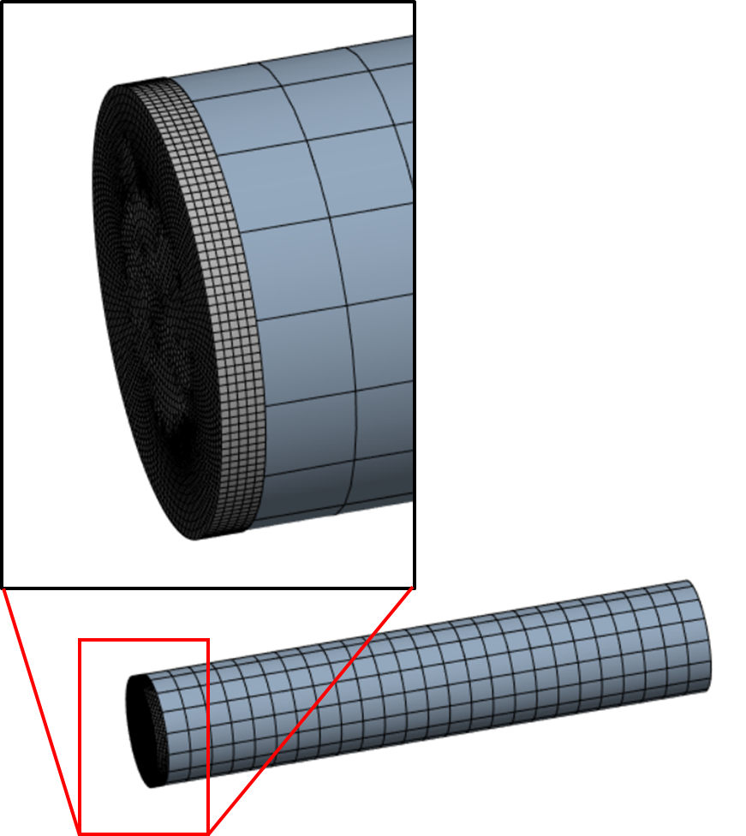
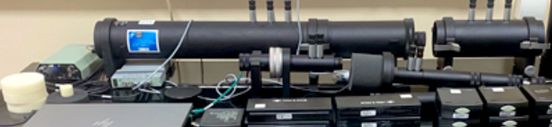

G6006\ Short term outcomes\ M3 \ current
Digital Twin
FEM model
Notes:
During the implementation of stage M3, the partners from Uzbekistan delivered samples of the developed porous acoustic materials.
These samples were tested to determine their acoustic characteristics.
The tests were conducted by the partners from the University of Niš. For this purpose, equipment supplied with funding under the project was used.
The partners from the Institute of Mechanics proposed a mathematical model describing the behavior of the developed porous materials. Numerical modeling of the experiment was carried out based on a advanced numerical method -FEM.
The created digital twin of the model depends on 4 material parameters. The model makes it possible to obtain a series of numerical solutions to be used in the training of machine learning algorithms.

Slide 11
G6006\ Outcomes
During the implementation of the project at stages M1-M3, the following main results were obtained:
  Composite porous acoustic materials were developed on the basis of by-products of rice production obtained from a grain processing company in Uzbekistan.
  Test samples have been prepared to investigate the acoustic characteristics of these materials.
  Tests to determine acoustic characteristics with an impedance tube
  A digital twin of the impedance tube experiment was developed
PUBLIC
Notes:
Summary of the main results in the implementation of the tasks from M1-M3.

Slide 12
G6006\ Scientific Successes\Publications
  Sound Absorption coefficient measurement methods in reverberation room and impedance tube / D. Mihajlov, M. Prascevic, P. Jovanovic, R. Iankov and N. Abed // Facta universitatis, Series: Working and Living Environment Protection, Vol. 21, No. 1, 2024 (the manuscript is accepted for publication, article review acknowledgement 11. 04. 2024)
  Methodology for uncertainty estimation of long-term environmental noise measurements / D. Mihajlov, M. Prascevic, M. Raos and R. Iankov (the manuscript is submitted for publication in Technical Gazette, ISSN 1330-3651(Print), ISSN 1848-6339 (Online), 03. 04. 2024)
  Assessment of representative measurement time intervals for environmental noise monitoring / D. Mihajlov, M. Prascevic, M. Raos and B. Radicevic (the manuscript is submitted for publication in Technical Gazette, ISSN 1330-3651(Print), ISSN 1848-6339 (Online), 15. 04. 2024)
  Overview of common methods for fire testing / M. Protic, N. Misic, M. Raos, M. Mancic and M. Popovic (the manuscript is submitted for publication in Facta universitatis, Series: Working and Living Environment Protection, ISSN 0354-804X (Print) ISSN 2406-0534 (Online), 12. 04. 2024)
  Performance assessment of solar thermal heat storage / M. Mancic, M. Raos, M. Medenica, M. Protic, M. Popovic, M. Mancic (the manuscript is submitted for publication in Facta universitatis, Series: Working and Living Environment Protection, ISSN 0354-804X (Print) ISSN 2406-0534 (Online), 10. 04. 2024)
  Promising acoustic materials to reduce noise and improve the environmental situation in production facilities and transportation / N. Abed, R. Iankov, M. Datcheva, A. Alexiev, A. Bozorov, S. Sultanov, S. Bukharov, M. Prascevic. Journal "Acoustics", XXV, 2023, ISSN:1312-4897 (the results presented at the National Conference “Acoustics 2023”, 15.-16.12.2023, Sofia, Bulgaria, the manuscript accepted for publication in December 2023)
  Sound absorption of rice husk as promising biomass filler of noise reducing composites / N.Abed, R. Iankov, A. Alexiev, S. Bukharov, M. Prascevic, D. Mihajlov. Journal "Acoustics", XXV, 2023, (the results presented at the National Conference “Acoustics 2023”, 15.-16.12.2023, Sofia, Bulgaria, the manuscript accepted for publication in December 2023), ISSN:1312-4897
PUBLIC

Slide 13
G6006\ Scientific Successes\Publications
Advanced sound absorbing materials to reduce noise and improve the environmental situation in production facilities and transportation / Abed, S.N. et al. // 7-th International Scientific and Technical Symposium “Porous permeable materials: technologies and products based on them", October 19-20, 2023 (the manuscript is accepted for publication)
Manuscripts in preparation: a journal paper with working title “Green and sustainable materials for noise control. A review” to be submitted to Engineering Sciences, ISSN 1312-5702; a conference paper on natural and waste material composites as acoustic materials to be submitted to Acoustics 2023, a conference to be held in Sofia, 15-16. December 2023.
Conference presentations and public lectures
Presentations at the International Conference "NDT Days" 2023, June 12-16, 2023, Sozopol, Bulgaria
Iankov R., Acoustic Multi-Functional Composites for Environmental Risks and Health Hazards Reduction, presentation, session "Modern testing methods and technologies"
Round Table "Presentation of the Project NATO SPS MYP G6006: Acoustic Multi-Functional Composites for Environmental Risks and Health Hazards Reduction" (RT.III)
https://www.bg-s-ndt.org/NDT_Days/2023/2023_program.html
PUBLIC

Slide 14
G6006\ Scientific Successes\ Conferenses
Kick-off meeting, may 10, 2023; Sofia, IMech BAS; Head Office: Dr. Claudio Palestini and Eleonora Colonna (online); FT-TSTU: Nodira Abed (online); FOS UNI- D. Mihajlov, M. Lukic, Momir Prascevic (online);
Work meeting 2: september 01, 2023; Niš, FOS UNI; FOS UNI: M. Raos , M. Prascevic, D.Mihajlov, M. Lukic;IMech BAS: R. Iankov, M. Datcheva, A. Alexiev.
Workshop: Acoustic parameters in porous materials, February 6, 2024; Imech BAS; FOS UNI: M. Prascevic, M. Raos, D. Mihajlov, P. Jovanović; IMech BAS: R. Iankov, M. Datcheva, Al. Alexiev, M. Rashevski
Int. Conference "NDT Days" 2024, Sozopol, Bulgaria; June 10-14, 2024; Round table „Presentation of the NATO SPS MYP G6006; FOS UNI: M. Prascevic, M. Raos, D. Mihajlov, P. Jovanović; IMech BAS: R. Iankov, M. Datcheva, Al. Alexiev, FT-TSTU: N.Abed, Bozorov A.
Workshop: Testing acoustical properities of absorption materials by impedance tube; UNI Nis August 29, 2024; FOS UNI: M. Prascevic, M. Raos, D. Mihajlov, P. Jovanović; IMech BAS: R. Iankov, M. Datcheva, Al. Alexiev
14th National Congress on Theoretical and Applied Mechanics, Sofia, Sept 2-4, 2024
8th Annual Meeting of the Bulgarian Section of SIAM. December 11 - 13, 2023, Sofia, Bulgaria.
PUBLIC

Slide 15
G6006\ Successes
  Educational successes (number of young scientists involved)
Stipends for young researchers (up to 2 stipends per partner)
  Milan Rashevski (BG) Post Doc: 36 months (1-36)
  Youliy Afazari (BG) Eng.: 12 months (1-12)
  Milena Manic (RS) PhD Student: 8 months (1-8)
  Petar Jovanovic (RS) PhD Student: 28 months (9-36)
  Nikola Micic (RS) PhD Student: 36 months (1-36)
  Aminjon Bozorov (UZ) Post Doc: 36 months (1-36)
  Sanjar Sultanov (UZ) Post Doc: 36 months (1-36)
  Training - Operation and measurements with
    acoustic camera (Acoustic Camera Type 9712-W-FEN), Sofia
    Impedance tube(Bruel&Kjaer 4206-T with LAN-XI module ), Nis
    Oberst beam (Vibration system for the analysis of dynamic characteristics) (online)
PUBLIC

Slide 16
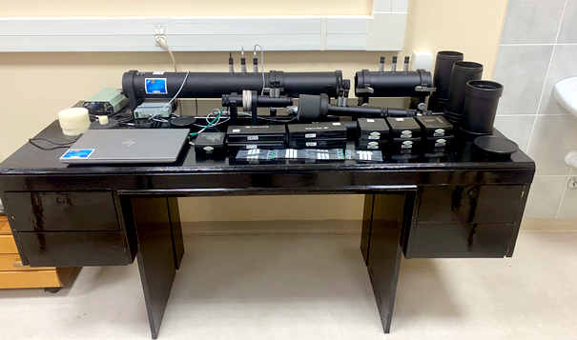
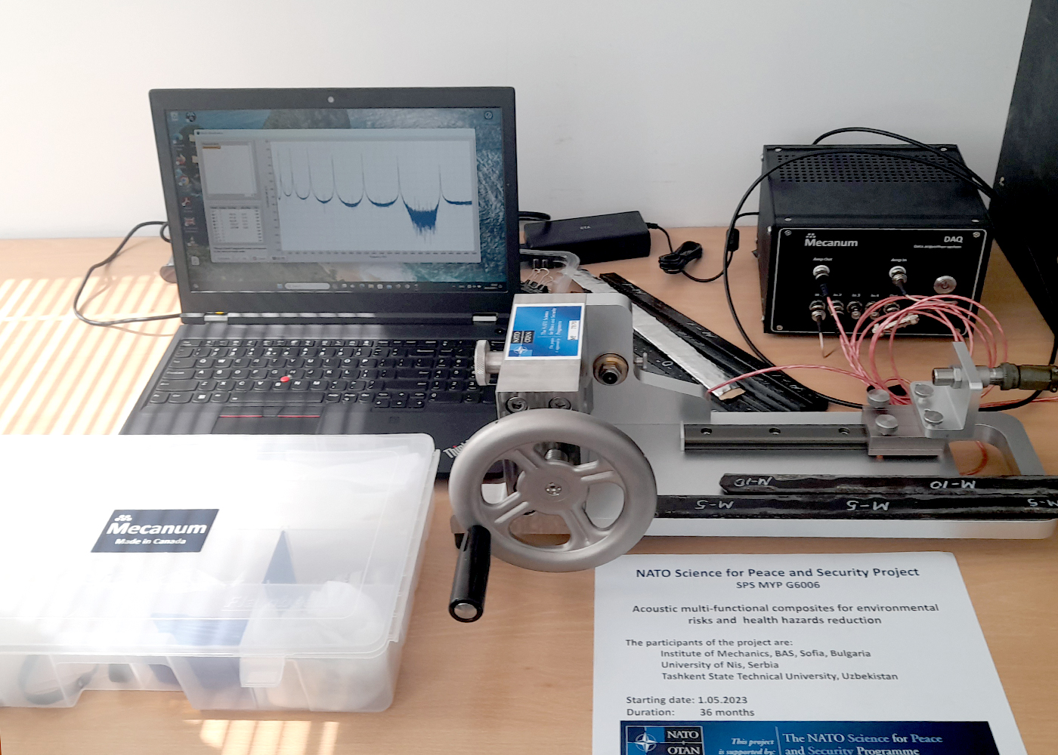
G6006\ Successes\Equipment
FOS UNI: Transmission Loss Tube Kit, type Bruel&Kjaer 4206-T with LAN-XI module (4ch input and 1ch output) and Pulse Material Testing Software
SPS Label № 7827
TS TU, Tashkent, Uzbekistan:
Vibration system for the analysis of dynamic characteristics
of acoustic materials according to the Oberst method
SPS Label № 7870
PUBLIC
Notes:
With the financial support from the project, the following equipment was delivered

Slide 17
G6006\ Impact
  In its scientific field: Development and Implementation of cost-effective environmental friendly sound absorbing materials for noise reduction in vehicles, buildings and large spaces; development of a methodology for assessment of the acoustic properties of sound isolating materials based on natural raw materials. Novel solutions for resilience to man-made, technological and natural hazards employing advance materials and artificial intelligence/ machine learning
  On security: Noise reduction and absorption, based on natural raw materials, can be related to security issues in several ways: Building Security and Privacy; Infrastructure Security; Sustainability and Compliance; Disaster Response and Emergency Situations
  On society: improve the noise ecology and acoustic safety at workplaces in closed production rooms, in the salons and cabins of vehicles, in other localized volumes, which will subsequently help to maintain the health of personnel, reduce the risk of industrial accidents, and increase the safety of transport services.
PUBLIC
Notes:
The results of the project have an impact in the following areas

Slide 18
Way Forward
Scientific:
  Development of ML methods to identify material properties in new acoustic materials.
  Development of research methods that make it possible to reduce the time from design to market.
  Low total system cost.
Commercial:
  Implementation of the materials in areas that improve the quality of life.
PUBLIC
Notes:
During the implementation of the next milestones of the project, activities will continue on the following main scientific and commercial tasks

Slide 19
Way Forward\M4 tasks
Description of work
Task 4.1 (FOS UNI): To define process for production of acoustic composites and noise-reducing parts. To produce prototype samples of functional parts.
Task 4.2 (FOS UNI): To test the developed materials and products from them in the design of communal vehicles or other type of vehicles, industrial machines or building structures. To test representative materials of interest in an anechoic chamber.
Task 4.3 (FOS UNI): To perform real-time monitoring of the composite characteristic behavior using developed setup in M3, and output the data to the database.
Task 4.4 (FT-TSTU): To develop technology for producing vibration and noise-absorbing composites and noise-reducing parts. To produce experimental samples of functional parts.
Task 4.5 (FT-TSTU): To carry out vibration and noise tests the developed materials and products from them in the industrial premises at flax- cotton processing and metallurgical enterprises.
PUBLIC

Slide 20
